Slide 1
Introduction to MC68332
The MC68332 is a high-performance 32-bit microcontroller developed by Motorola (now NXP).
It combines a CPU32 core, a rich set of peripherals, 2KB of on-chip standby static RAM (SRAM) , and a flexible bus system on a single chip.
Designed for real-time embedded applications, it is especially popular in automotive, industrial, and aerospace systems.
The CPU32 core is a reduced version of the 68020-instruction set, optimized for embedded control.
Integrated modules include:
  Time Processor Unit (TPU) for precise timing operations
  Queued Serial Module (QSM) for serial communications
  System Integration Module (SIM) for system-level control
  2KB standby SRAM – providing fast, low-latency memory access for real-time operations, without relying on external RAM

Slide 2
MC68332 Block Diagram
CPU32
Time Processor Unit (TPU)
System Integration Module (SIM)
Address Bus
Intermodule Bus
Data Bus
Queued Serial Module (QSM)
2K Standby SRAM

Slide 3
CPU32
CPU32
A 32-bit core, executes instructions and handles logic/control tasks.
Time Processor Unit (TPU)
System Integration Module (SIM)
Address Bus
Intermodule Bus
Data Bus
Queued Serial Module (QSM)
2K Standby SRAM

Slide 4
Time Processor Unit – (TPU)
Time Processor Unit (TPU)
A powerful timing co-processor used for real-time and event-driven applications (e.g., PWM, pulse counting).
CPU32
System Integration Module (SIM)
Address Bus
Intermodule Bus
Data Bus
Queued Serial Module (QSM)
2K Standby SRAM

Slide 5
Queued Serial Module (QSM)
CPU32
Time Processor Unit (TPU)
System Integration Module (SIM)
Address Bus
Intermodule Bus
Data Bus
Queued Serial Module (QSM)
Manages serial communication using SCI (Serial Communication Interface) and SPI (Serial Peripheral Interface).
2K Standby SRAM

Slide 6
2K Standby SRAM
CPU32
Time Processor Unit (TPU)
System Integration Module (SIM)
Address Bus
Intermodule Bus
Data Bus
Queued Serial Module (QSM)
2K Standby SRAM
On-chip fast memory for storing temporary data or variables during program execution.

Slide 7
System Integration Module (SIM)
CPU32
Time Processor Unit (TPU)
System Integration Module (SIM)
Chip Select Logic
System Protection Logic
Clock Generator
Watchdog Timer
Bus Interface Control
Interrupt Control
Reset Control Logic
Address Bus
Intermodule Bus
Data Bus
Queued Serial Module (QSM)
2K Standby SRAM

Slide 8
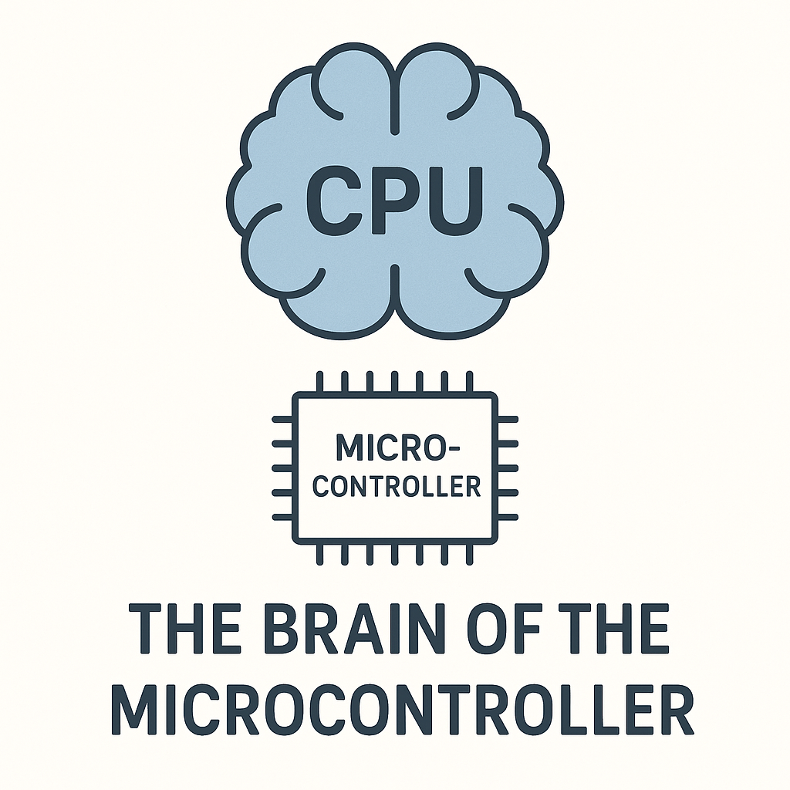
Central Processing Unit - CPU32
1. 32-bit Registers:
8 Data (D0–D7) & 7 Address (A0–A6) + Stack Pointer (A7)
Supports efficient data handling & memory access
2. 32-bit ALU:
Performs arithmetic, logic, bit manipulation
Supports signed/unsigned multiply & divide
3. Enhanced Instruction Set:
Based on 68000 core with extensions
Bit field ops, branching, looping, table lookup
4. Advanced Addressing Modes (14 types):
Indexed, pre/post increment, PC-relative, memory indirect, etc.
Ideal for structured data access
5. Fast Interrupt System:
7 levels (Level 7 = NMI), auto-vectoring, nesting
Real-time responsiveness for control systems

Slide 9
Central Processing Unit - CPU32
6. Prefetch & Pipelining:
Instruction queue & 2-stage pipeline
Boosts execution speed and efficiency
7. Exception Handling:
Handles bus/address errors, illegal ops, interrupts
Uses vector table for fast dispatch
8. User/Supervisor Modes:
Enables memory protection & multitasking
Supervisor mode has full system access
9. Real-Time Embedded Support:
Tight integration with TPU, QSM, and SIM
Designed for automotive & industrial control

Slide 10
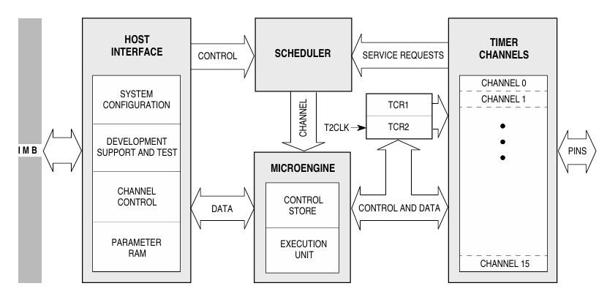
Time Processor Unit – (TPU)
Dedicated Timing Co-Processor
TPU operates partially independent of the CPU, offloading complex timing tasks like PWM, capture/compare etc..
16 Programmable Channels
Each channel can be configured individually for different timing functions, making the TPU highly flexible and suitable for multiple simultaneous operations.
Microcoded Execution Engine
TPU runs its own microinstructions from a ROM (or optional RAM), enabling customizable and autonomous timing control without CPU intervention.
Parameter RAM & Scheduler
Parameter RAM stores data for each channel, and a built-in scheduler manages task.

Slide 11
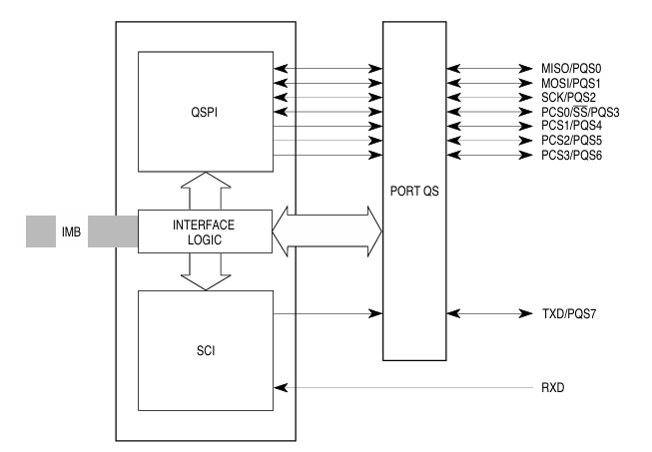
Queued Serial Module – (QSM)
1. SCI (Serial Communications Interface)
Used for asynchronous serial communication (like UART)
Supports full-duplex communication (Rx and Tx simultaneously)
Common baud rates (e.g., 9600, 19200, 115200, etc.)
Includes:
  Transmit Shift Register (TSR)
  Receive Shift Register (RSR)
  Control and status registers
Typical use: Communication with PC, GPS modules, other MCUs
2. SPI (Serial Peripheral Interface)
Used for synchronous communication
Supports Master/Slave mode
Operates on a clock line (SCK), MOSI, MISO, and CS
Includes:
  Data buffers (Tx, Rx queues)
  Clock polarity/phase configuration
  Chip-select logic
Typical use: Communication with EEPROM, ADC, DAC, sensors, etc.

Slide 12
2KB Standby RAM & TPU Emulation
SRAM
The MC68332 includes 2 Kilobytes of Static RAM (SRAM) built directly into the chip.
Called "Standby" RAM because it can retain its data as long as the chip is powered — even if the CPU is idle or in a low-power state.
Fast access, no need for external memory.
Shared between CPU and TPU using the internal Intermodule Bus (IMB).
Use Cases: Storing runtime variables, buffers, flags
TPU Emulation Mode
Normally, the TPU (Time Processor Unit) runs preloaded firmware (microcode) from ROM.
In TPU Emulation Mode, custom microcode can be loaded into RAM — allowing the TPU to run user-defined timing functions.
This is useful for developing or testing new TPU features without burning them into ROM.

Slide 13
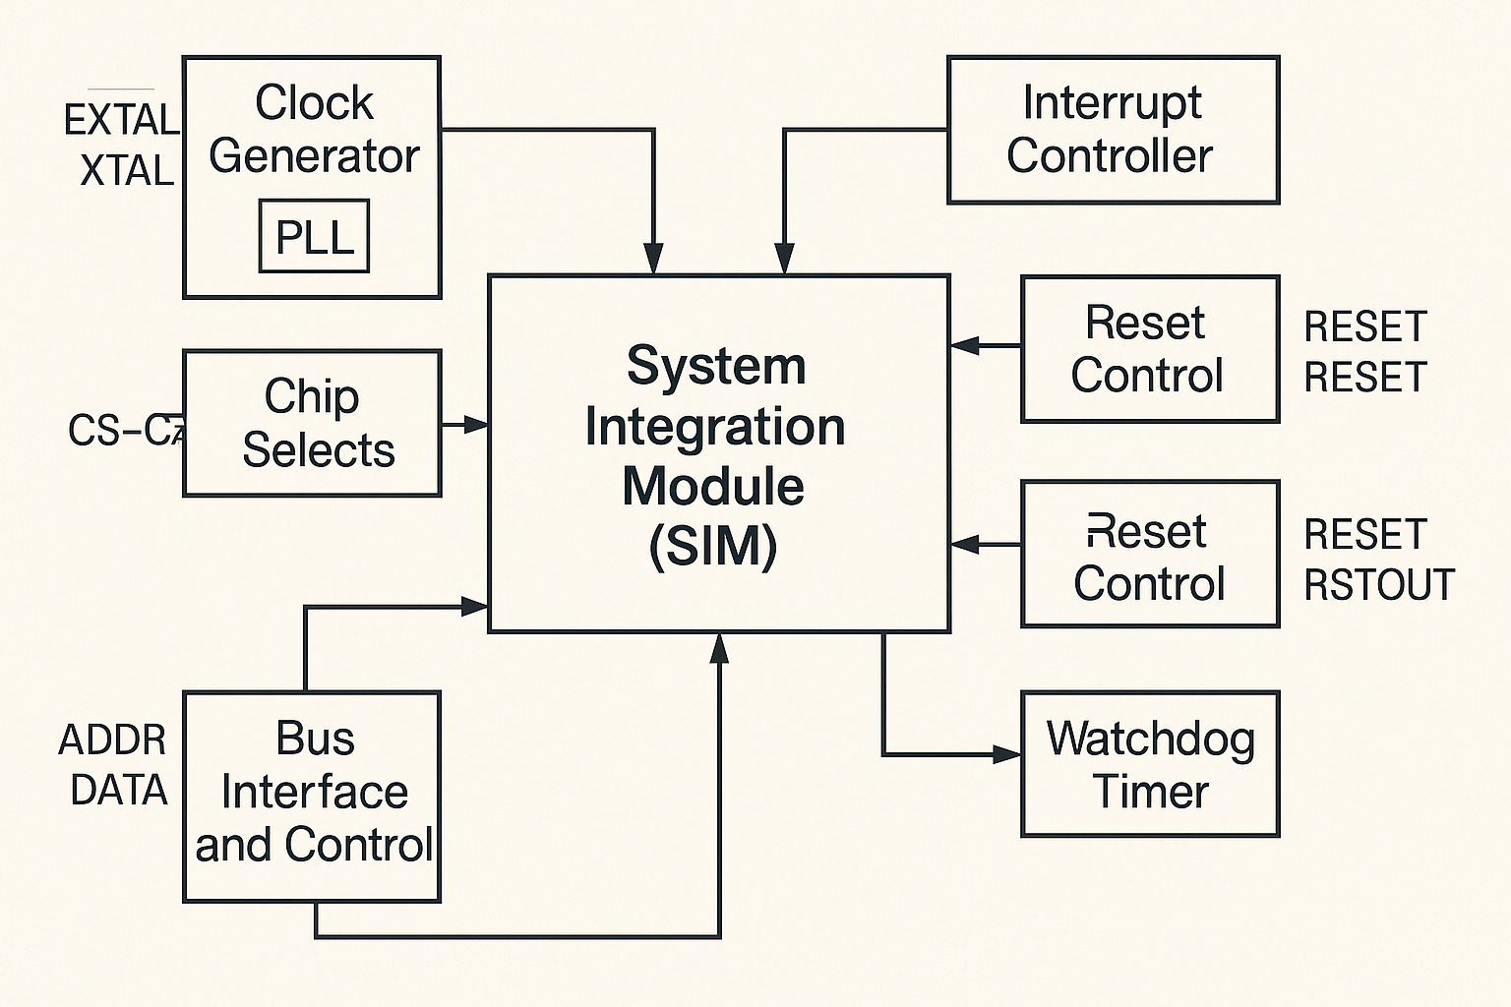
System Integration Module (SIM)
1. Clock Generation (PLL):
Generates internal clock from external oscillator
Feeds CPU, TPU, QSM with configurable frequencies
2. Chip Select Logic:
8 programmable CS signals (CS0–CS7)
For interfacing external RAM, ROM, peripherals
3. Reset Control:
Handles Power-On, Watchdog, Software, and External resets
Ensures safe and reliable system startup & recovery
4. Interrupt Controller:
Prioritizes & routes internal/external interrupts
Supports auto-vectoring & nested interrupt handling
5. Watchdog Timer:
Monitors system health
Auto-resets CPU on software failure/hang
6. Bus Interface Control:
Manages external address/data bus signals
Configurable wait states & access timing

Slide 14
Interrupt System
The MC68332 supports a robust 7-level interrupt system (IPL0–IPL2), where level 7 is non-maskable.
Each interrupt source is mapped to a vector number, directing the CPU to the appropriate ISR.
Internal modules like TPU and QSM generate interrupt requests.
Interrupt Vector Table holds ISR addresses in memory.
Supports Auto-vectoring (default service) and User-defined Vectors (custom handling).
Nested and masked interrupts allow fine-grained control.
Memory Map & Address Space
24-bit address space supports up to 16 MB of addressable memory.
Internal blocks: CPU registers, TPU, SIM, QSM, and 2K SRAM are memory-mapped.
External memory/peripherals mapped using Chip Selects (CS0–CS7).
Reserved address areas protect system-critical zones.
Chip Selects configured through SIM for flexible memory expansion.

Slide 15
Bus Interface & External Access
24-bit address bus and 16-bit data bus enable external memory interfacing.
Bus control signals: AS, DS, RW, BG, BR, facilitate timing and data flow.
SIM allows programming of wait states to match peripheral speeds.
Chip selects manage address decoding for external components.
Bus arbitration supports shared bus environments (multi-master).
Power Management & Low-Power Modes
SIM supports clock gating to disable unused modules.
Reduced clock frequencies via PLL for lower power consumption.
Standby or idle modes conserve energy during inactivity.
Wake-up triggers include external interrupts and timers.
Ideal for automotive and battery-powered applications.

Slide 16
System Clocking & PLL
External clock (EXTAL/XTAL) is the source for the Phase-Locked Loop (PLL).
PLL multiplies the base clock to generate higher frequencies for the system.
Clock outputs are distributed to CPU32, TPU, QSM, and SIM. User-configurable dividers allow power/performance tuning.
Clock monitors and watchdog ensure stable operation.
Reset Logic & Boot Process
Reset sources include Power-On Reset, External Reset pin, Watchdog timeout, and Software Reset instruction.
The SIM handles reset logic and generates RSTOUT signal.
On reset, the CPU fetches PC and SR from a predefined vector address in ROM.
Ensures a clean system startup and consistent configuration.
Watchdog integrated to handle software faults by resetting the system.

Slide 17
Development & Debugging Tools
Background Debug Mode (BDM) allows real-time monitoring of system state.
Supports breakpoints, single-step execution, and register inspection.
In-circuit emulators (ICE) and Motorola Evaluation Modules (EVMs) aid development.
Supported by tools like P&E Micro and Lauterbach TRACE32.
Useful for firmware development, hardware testing, and system validation.

Slide 18
THANK YOU

